Slide 1
Prediction and Recommendation engine with Data crunching and Causal models for Demand Analysis of food grains
Project Coordinator- Sankaranarayanan.G
Project Members: Praveen Malla, Keerthana.S, Kasyap Varanasi, Nikunj Bansal, Praveen Shahani (Members of Cord.Ai)

Slide 2
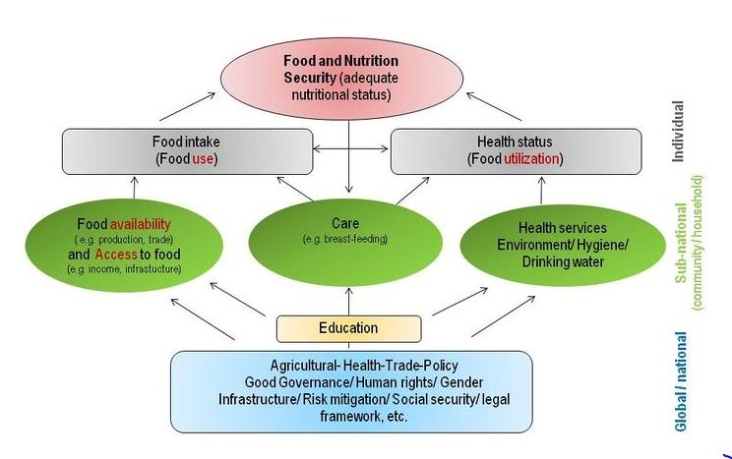
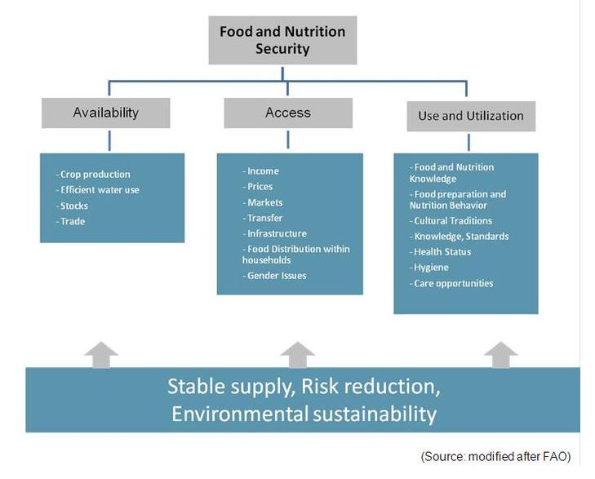
Food Security

Slide 3
Food Security
Quantity of certain food grains copious
Other aspects need to be considered
The Health dimensions and Inclusive dimension
Availability part has been met with volatility and procurement challenges
Actual or Near Actual Demand Assessment essential.
Intelligent market system design-Need of the hour
Information sharing done between stakeholders and misinformation reduced.
Policies considered- Doubling farmers income, National Logistics Policy

Slide 4
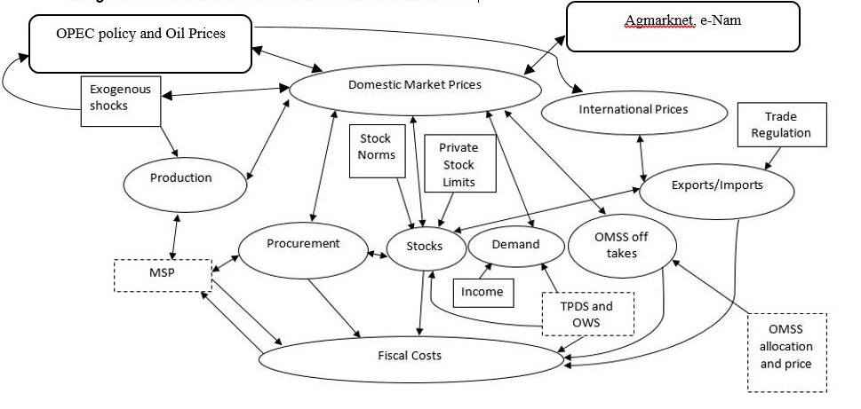
Working and Dynamics of Domestic Market

Slide 5
Effect of International Markets on Domestic Markets
Fuel price dynamics and Energy Crisis
Currency Value dynamics (Appreciation and Depreciation of exchange rate)
Geopolitical changes
Famines/Drought around the world and consequent demand variation.
Climate change and volatility-El-nino, La-Nina Effects and intersection with minor oscillations.
World food grain and commodity prices
Demand for substitute products or economic alternatives
Demand for food grain derivatives – Eg. Atta, Other Consumables

Slide 6
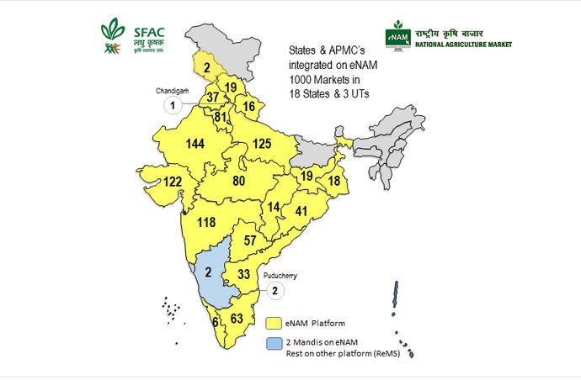
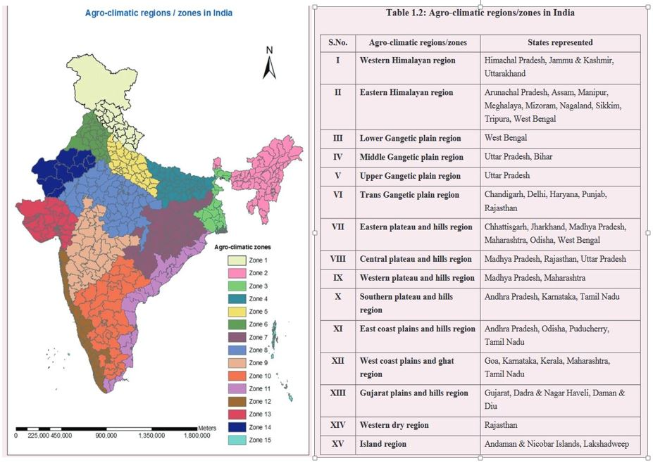
APMC Maps

Slide 7
Problems, Issues and Challenges-Supply
Major market forces (Government or Government Allied Channel Pricing and Private/Open Market Channel Pricing)
Yield Prediction
Volatility in Yield, Produce and Procurement- Forced Imports to compensate for supply shortage.
Import of Edible oil- Palm oil (80 lakh tonne/year), Soya oil (35 Lakh tonne/Year), Sunflower oil (20.7 Lakh Tonne/year)
Climate related risks- Pulses(Damage due to untimely rain), Paddy, Wheat
Price depends on production-India, Bangladesh, Pakistan, Mynmar(Burma)
Labour related risks
Soil related risks – Marginalized land-Pulses (Nitrogen Fixing ability), Improves soil fertility.
Water related risks – Depends on Irrigation facilities and Crop Phenotype.
Variation of Input costs- Fertilizer, Pesticides, Manpower(500/per day)(varies from state, season ), Seeds.

Slide 8
Problems, Issues and Challenges-Supply
Disproportionate pricing of a crop
Agro-climatic issues
Destruction of Inventory due to inclement weather or natural calamities
Loss of Land due to Urban Sprawl or Industrial encroachment- Decline of cultivable land.
Landlords of Micro, Small and Marginalized farmers- Ownership rights, north and eastern India.
Stubble burning- Nutrient loss and climate issues.
Pest , Locust, Rodent attacks- Post harvest Losses.
Leakages and Pilferages
Spoilage
Middle men- Intermediaries
Corporate/Private/Commercial farming- stockist of farm produce to push up prices.
Small, marginilized farmers- 80-85%

Slide 9
Problems, Issues and Challenges-Supply
Cost- Increase in the cost of raw materials, labour, production and machinery cost and pricing further down the supply chain.
Inventory Policies to balance between safety stocks, spoilage and maintain the inflation levels.
Taxation policies, Fiscal Deficit, Fuel prices and Policies
Information asymmetry, heteroscedasticities, Incompleteness.

Slide 10
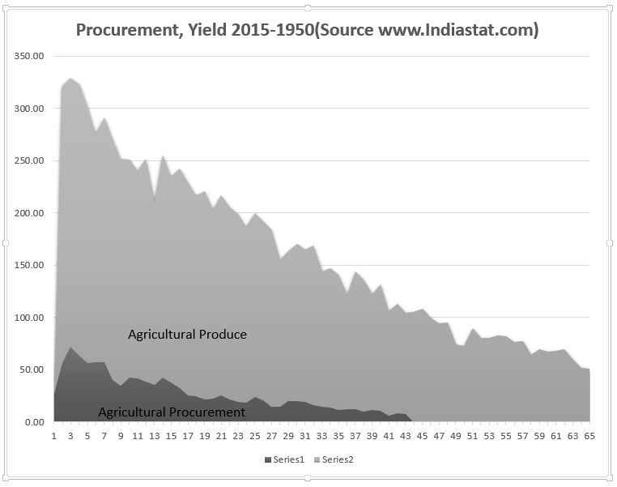
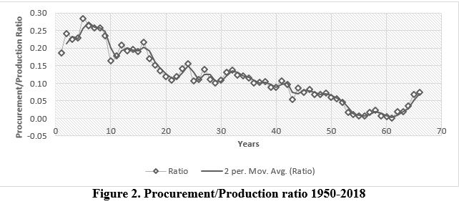
Problems, Issues and Challenges -Supply

Slide 11
Problems, Issues and Challenges -Demand
Population Dynamics.
Poverty Level Estimation
Free riding, pilferages and Leakages
Exports and Imports Policies
Delay in trans-shipment
Delay in last mile distribution
Exclusion of poor due to non-availability of ration cards and Aadhar card
Sudden increase in demand
Spoilage due to weather
Incomplete and Imperfect information.

Slide 12
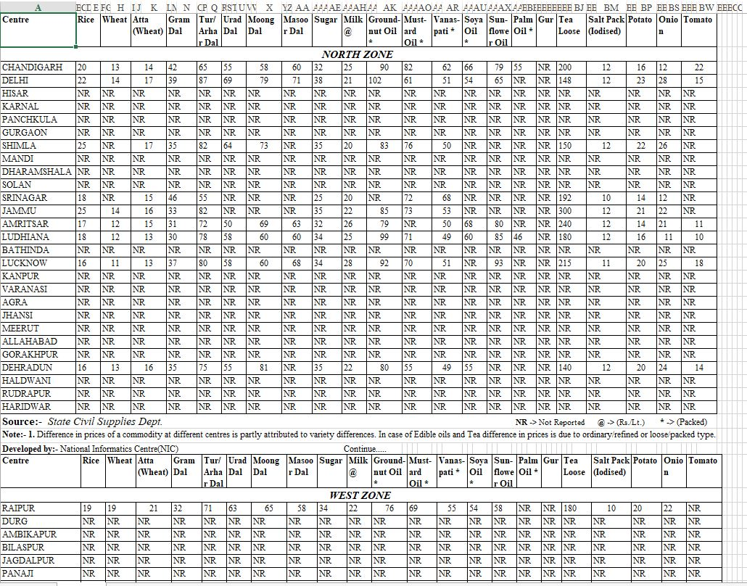
Data Noises

Slide 13
Objectives
Supply Side Strategizing and Planning to meet the Demand using Artificial Intelligence, tools and technological implements.
Inventory and Logistical Management at Facility level using technological implements such as smart cards.
Demand Prediction, Analysis Model, and Algorithms for different geographical locations in India.

Slide 14
Implementable, Deliverables-Problem Framework, Algorithm and Mechanisms
Module 1: Numerical data analysis
Module 2: Textual Data Analysis
Module 3: GIS and Climate based Data analysis, Image Analysis
Module 4: Data Cleaning Module
Module 5: Synthetic Data Generation, test data generation and validation
Module 6: Retrograde analysis of food grain policies and other policies in reality
Module 7: Forecasting, Recommendation and Strategic Decision Making Module

Slide 15
Module Relationship Diagram
Module 1
Module 4
Pre-processed
Data
Module 2
Retrograde
Analysis
Module 6
Validated Synthetic
Data
Module 3
Module 5
Module 7
Output

Slide 16
Module 1-Numerical Data Analysis-I Temporal Forecast
Production, procurement forecast
Population Dynamics-State-wise, District Wise
Ensemble , LSTM
Demand Forecast-1
MSP, Open Market Price Inter-Commodity price parity
Inter channel price parity
Inventory levels and Take off rate

Slide 17
Module 1-Numerical Data Analysis-I- Spatial variation forecast
Quantity ratio of constituents
Quantity and Frequency of consumption
Local Cuisines
Population, Dynamics-State-wise, District Wise
BERT
Other Cuisines
Local food crops, varieties and produce
Demand forecast -2
List of hotels, supermarkets, markets

Slide 18
Module 1 –Outcomes
Demand of 25 commodities for each District and different markets
Modified MSP, pricing, contracts and Incentive for farmers, Pricing strategy for reducing efficiency of middle men and cartels
Demand Forecast-1
Prediction of yield, produce and market arrivals
Inventory levels at each echelon of warehouse allocation and Reallocation of commodities
Demand forecast -2
Spatio-temporal variation of Ceiling Demand for each crop , commodities along with Open market demand

Slide 19
Module-2 Textual Data Analysis
Newspaper articles, Educational and Expert Videos
Audit Report, Policy reports, Memo Scans
BERT(Processing past and Real time Data)
Spatial Variation -1
Budget, Economic Reports
Farmer’s database, Soil Health Cards
Tweets, Youtube comments

Slide 20
Module-2 Textual Data Analysis Outcomes
True information from trusted sources, fake information, comments, tweets rumours, propaganda
Audit Report, Policy reports, Memo Scans, Budget, Economic Reports Core constraints, policies framework related parameters for each of the geographical location
Spatial Variation -1
Farmers number, holdings, soil type, nutrient pH and possible reallocation of agro climatic zoning.
Updates in policies and feedback to the existing framework of models-Causality
Understand Differences in perceptions, opinions, belief dynamics to strategize

Slide 21
Module 3: GIS and Climate based Data analysis, Image Analysis
Agro-climatic Zoning Physical map data
Crop Phenotype and effect of weather, climate on the phenotypes
QGIS/ArcGIS/GIS Unit+ CV+NLP Unit
Spatial variation -2
Soil classification, Urban Sprawl Geographical location, Irrigation routes
Feedback
Objection detection and analysis
Demand Points and market locations
Transportation routes approximation distance parameters and alternatives

Slide 22
Module 3: GIS and Climate based Data analysis, Image Analysis- Outcomes
Effect of climate on yield, produce, Inventory, transportation routes, location and delays
Effect of Climate on Crop Phenotype
Arrival, Demand Dynamics with spatiotemporal variation and Alternate Market locations with cost
Spatial variation -2
Water Availability with Spatio-temporal variation
Best routes with alternatives for transportation of commodities with cost
Real time Analysis of the agricultural field, Feedback on pest, locust, rodent invasion
Loss of Water resources, Cultivable Land

Slide 23
Module 4: Data Cleaning Module
Missing Data, Imperfect data, Data noises variation of data frequency
Validated Synthetic Data
Accuracy Precision Positional Labelling GIS Errors
Data Pre-processing Unit
Pre-processed Clean Data
Fake News, Misinformation, Online Opinions (Unstructured Data)
Misclassification of Images and Spatial Accuracy Captured by Lidar Drone
Errors due to Format Conversion and Data Pre-processing Algorithms

Slide 24
Module 4: Data Cleaning Module
Imputed Data and Data Devoid of Missing Data, De-noised Numerical Data , Data made structured
Denoised GIS data with better location, positional, accuracy and precision ,classification with better accuracy
Pre-processed Clean Data
Fake news, misinformation, imperfections ironed out prevented from spreading further
Format conversion errors, tabulation data related errors, extraction of numerical data from images

Slide 25
Module 5: Synthetic Data Generation, test data generation and validation
Random Data Generation
Wholesale, Retail Market Price, Demand, Supply
Procurement, Production Data, Inventory Level, Take off rate
SyntheticData Generator
Synthetic Data Generated
Population Dynamics
Validation of Data
Inter-Commodity and Inter-Channel Price Parity
Validated Synthetic Data
Climate and weather dynamics

Slide 26
Module 5: Synthetic Data Generation, test data generation and validation
Synthetic Climate and Weather Data
Validated Synthetic Supply, Demand Data
Validated Synthetic Data
Validated Synthetic Domestic Price Data-Inter-commodity, Inter-channel price parity
Validated Synthetic International Price Data-Oil, Commodities, Food grains
Validated Population dynamics, explosion
Validated Inventory Level, take off rate

Slide 27
Module 6: Retrograde analysis of food grain policies and other policies in reality
Historical Data Across Years
Analysis Feedback with Learning
Newspaper articles, Educational and Expert Videos
Audit Report, Policy reports, Memo Scans
Transformer
BERT(Processing past and Real time Data)
Spatial Variation -1
Budget, Economic Reports
Retrograde Analysis
Farmer’s database, Soil Health Cards
Newspaper articles, Educational and Expert Videos
Tweets, Youtube comments
Audit Report, Policy reports, Memo Scans
BERT(Processing past and Real time Data)
Spatial Variation -1
Budget, Economic Reports
Real time Data (Apache Kafka)
Farmer’s database, Soil Health Cards
Tweets, Youtube comments

Slide 28
Module 6: Retrograde analysis of food grain policies and other policies in reality-Outcomes
Effect of policy implementation over years on the systems
Retrograde Analysis
Effect of New policies introduced into the system
Best course of action to implement a balanced policy⁕
⁕Balanced Policy- A Policy that would benefit all the stakeholders involved

Slide 29
Module 7: Forecasting, Recommendation and Strategic Decision Making Module
Demand Forecast-1
Spatial Variation -1
Forecasting , prediction and Analysis of Demand, Procurement, Produce, Yield
Recommendation of Inventory levels and Allocation of Inventory at Each Echelon with Spatial Variation
Pre-processed Clean Data
Deep Learning Networks with Logic and Reasoning (Multiple models combining outputs/Auto ML), Deep ChaosNet
Validated Synthetic Data
Analysis Feedback with Learning
Spatial variation -2
Demand forecast -2

Slide 30
Module 7: Forecasting, Recommendation and Strategic Decision Making Module-Outcomes
Demand Forecast, Supply Forecast, Produce Forecast with existing and new policies with International and Domestic pricing
Forecasting , prediction and Analysis of Demand, Procurement, Produce, Yield
Recommendation of Inventory levels and Allocation of Inventory at Each Echelon with Spatial Variation
Inventory levels at each echelon with existing and new policies
Allocation and Reallocation with existing and new policies

Slide 31
Strategy concept map for various stakeholders
Effect of policy implementation over years on the systems
Allocation and Reallocation with existing and new policies
Demand Forecast, Supply Forecast, Produce Forecast with existing and new policies with International and Domestic pricing
Inventory levels at each echelon with existing and new policies

Slide 32
References and Bibliography
Anon Climate Dynamics | Scientific improvements in seasonal weather forecasting; and climate variability from ocean surface and sea ice | AER. Retrieved (March 25, 2015), https://www.aer.com/science-research/climate-weather/climate-dynamics.
Anon Definition and Dimensions of Food Security. WOCATpedia. Retrieved https://wocatpedia.net/wiki/Definition_and_Dimensions_of_Food_Security.
Azar PD, Kleinberg R, Weinberg SM (2019) Prior independent mechanisms via prophet inequalities with limited information. Games Econ. Behav. 118:511–532.
Balseiro SR, Besbes O, Weintraub GY (2019) Dynamic mechanism design with budget-constrained buyers under limited commitment. Oper. Res. 67(3):711–730.
Benchekroun H, Martín-Herrán G (2016) The impact of foresight in a transboundary pollution game. Eur. J. Oper. Res. 251(1):300–309.

Slide 33
References and Bibliography
Benchekroun H, Martín-Herrán G, Taboubi S (2009) Could myopic pricing be a strategic choice in marketing channels? A game theoretic analysis. J. Econ. Dyn. Control 33(9):1699–1718.
Bergemann D, Välimäki J (2010) Information in mechanism design
Bergemann D, Välimäki J (2019) Dynamic mechanism design: An introduction. J. Econ. Lit. 57(2):235–274.
CAG (2013) Storage Management and Movement of Food Grains in Food Coporation of India
Capps O, Tedford JR, Havlicek J (1985) Household Demand for Convenience and Nonconvenience Foods. Am. J. Agric. Econ. 67(4):862–869.

Slide 34
References and Bibliography
CGIAR/CCAFS (1988) How will climate change affect food security ? (December):7.
Challinor AJ, Watson J, Lobell DB, Howden SM, Smith DR, Chhetri N (2014) A meta-analysis of crop yield under climate change and adaptation. Nat. Clim. Chang. 4(4):287–291.
Chatterjee S, Kapur D (2016) Understanding Price Variation in Agricultural Commodities in India: MSP, Government Procurement, and Agriculture Markets India Policy Forum. India Policy Forum.
Chen F, Samroengraja R (2004) Order volatility and supply chain costs. Oper. Res. 52(5).
Cho H (2016) The analysis of multivariate longitudinal data using multivariate marginal models. J. Multivar. Anal. 143:481–491.

Slide 35
References and Bibliography
Drèze J, Khera R (2015) Understanding leakages in the public distribution system. Econ. Polit. Wkly. 50(7):39–42.
Fiala P (2005) Information sharing in supply chains. Omega 33(5):419–423.
Graves SC (1996) A multiechelon inventory model with fixed replenishment intervals. Manage. Sci. 42(1):1–18.
Gulati A, Saini S (2015) Leakages from Public Distribution System (PDS) and the Way Forward. ICRIER Work. Pap. 294(January).
Hanjra MA, Qureshi ME (2010) Global water crisis and future food security in an era of climate change. Food Policy 35(5):365–377.

Slide 36
References and Bibliography
Hassanzadeh A, Jafarian A, Amiri M (2014) Modeling and analysis of the causes of bullwhip effect in centralized and decentralized supply chain using response surface method. Appl. Math. Model. 38(9–10).
Huang Y, Wang Z (2017) Information sharing in a closed-loop supply chain with technology licensing. Int. J. Prod. Econ. 191:113–127.
Information D (2019) Games of Incomplete 8 Dynamic
Kumbhar VM (2012) Impact of MSP on Area Under Cultivation and Level of Production: A Study of Selected Crops in India. SSRN Electron. J.
Lehrer E, Yariv L (1999) Repeated games with incomplete information on one side: The case of different discount factors. Math. Oper. Res. 24(1):204–218.

Slide 37
References and Bibliography
Li C, Liu S (2013) A robust optimization approach to reduce the bullwhip effect of supply chains with vendor order placement lead time delays in an uncertain environment. Appl. Math. Model. 37(3).
Liverman DM (1987) Forecasting the impact of climate on food systems: Model testing and model linkage. Clim. Change 11(1–2):267–285.
Ma J, Bao B, Ma X (2014) Inherent complexity research on the bullwhip effect in supply chains with two retailers: The impact of three forecasting methods considering market share. Abstr. Appl. Anal. 2014.
de Martí J, Zenou Y (2015) Network games with incomplete information. J. Math. Econ. 61:221–240.
Martín-Herrán G, Taboubi S (2015) Price coordination in distribution channels: A dynamic perspective q. Eur. J. Oper. Res. 240(2):401–414.

Slide 38
References and Bibliography
Meiselman, H.L; Macfie HJ. ed. (1996) Food Choice, Acceptance and Consumption First.
Mitra S, Mookherjee D, Torero M, Visaria S (2018) Asymmetric information and middleman margins: An experiment with Indian potato farmers. Rev. Econ. Stat. 100(1):1–13.
MLJ MOLAJ (2013) The National Food Security Act, 2013. (Dl):18.
Nath S, Zoeter O, Narahari Y, Dance CR (2015) Dynamic mechanism design with interdependent valuations. Rev. Econ. Des. 19(3):211–228.
Oh S, Özer Ö (2012) Mechanism Design for Capacity Planning Under Dynamic Evolutions of Asymmetric Demand Forecasts. Manage. Sci.

Slide 39
References and Bibliography
Ouyang Y, Daganzo C (2006) Characterization of the Bullwhip Effect in Linear, Time-Invariant Supply Chains: Some Formulae and Tests. Manage. Sci. 52(10):1544–1556.
Raghunathan S, Tang C, Yue X (2016) Analysis of the Bullwhip Effect in a Multi-Product Setting with Interdependent Demands. Forthcom. Oper. Res. (February).
Ray DK, Gerber JS, MacDonald GK, West PC (2015) Climate variation explains a third of global crop yield variability. Nat. Commun. 6.
Schneider HE, Mazer SJ (2016) Geographic variation in climate as a proxy for climate change: Forecasting evolutionary trajectories from species differentiation and genetic correlations. Am. J. Bot. 103(1):140–152.
Sourirajan K, Ramachandran B, An L (2008) Application of control theoretic principles to manage inventory replenishment in a supply chain. Int. J. Prod. Res. 46(21):6163–6188.

Slide 40
References and Bibliography
Stocking B (2015) Working Paper 297 The National Food Security Act ( NFSA ) 2013. (March).
Terelius H, Topcu U, Murray RM (2011) Decentralized multi-agent optimization via dual decomposition. IFAC Proc. Vol. (Elsevier), 11245–11251.
Wang H, Guo M, Efstathiou J (2004) A game-theoretical cooperative mechanism design for a two-echelon decentralized supply chain. Eur. J. Oper. Res. 157(2):372–388.
Wiebe K, Islam S, Mason-D’Croz D, Robertson R, Robinson S, Lotze-Campen H, Biewald A, et al. (2015) Climate change impacts on agriculture in 2050 under a range of plausible socioeconomic and emissions scenarios. Environ. Res. Lett. 10(8).
Yazdani A, Jeffrey P (2011) Complex network analysis of water distribution systems. Chaos An Interdiscip. J. Nonlinear Sci. 21(1):016111.

Slide 41
References and Bibliography
Zeballos LJ, Méndez CA, Barbosa-Povoa AP, Novais AQ (2014) Multi-period design and planning of closed-loop supply chains with uncertain supply and demand. Comput. Chem. Eng. 66:151–164.
Zhang P, Xiong Y, Xiong Z, Yan W (2014) Designing contracts for a closed-loop supply chain under information asymmetry. Oper. Res. Lett. 42(2).

Slide 42
Timeline
Duration Activity | Oct 2022-Nov 2022 | Nov 2022- Dec 2022 | Dec 2022- Jan 2023 | Jan 2023 –Feb 2023 | Feb 2023-Mar 2023 | Mar 2023- Apr 2023 | Apr 2023- May 2023 | May 2023-June 2023 | Jun-July 2023 | July- Aug 2023 | Aug-Sept 2023
Literature survey
Module 1
Module 2
Module 3
Module 4
Module 5
Module 6
Module 7
Combining and Testing

Slide 43
Budget
S.no | Resource | Amount (Rs)
 | Members (Human Resource) | 12, 00,000
 | Indiastat District | 14,514(for Single District under Regular Plan) with Limited no of tables, Plans could be customized accordingly
 | LiDAR Drones Landbot (Optional) | 8,27,852.50 – 19,04,060.75 ($10,000-23,000) Complex Drones ($50,000-3,00,000) 41,39,262.50-2,48,35,575.00
 | Thermal Sensors (Optional) | 1.2 Lakhs
 | Google TPU (Computational Resource) | Free( for Individual non commercial research GPU), Check Table
 | AWS (Computational Resource) | Needs Customized Plan
 | ArcGIS | 21,46,900 (ArcGIS pro/Advanced) 11,29,900 (ArcGIS Desktop Standard) 15,800/Year (ArcGIS Student)
 | QGIS | Free (Open Source)
 | Python , Java, C++, MongoDB with IDE | Free (Open Source)
TPU v4 Pricing | Price per chip-hour | % discount from on-demand
on-demand / evaluation | $3.22
1Y CUD (committed use discount) reservation | $2.03 | 37%
3Y CUD (committed use discount) reservation | $1.45 | 55%
Preemptible | $0.97 | 70%

Slide 44
Annexure-I

Slide 45
Annexure-I Data Noise

Slide 46
Lidar Drones
Drones choice: The payload capacity of both a lidar sensor and RGB camera needs to be taken into consideration.
About LIDAR Drones:
Lidar Drone Full Solution Providers
If you need a full lidar drone solution, then the below providers have packages and expertise to put a full solution together for you.
OnyxScan Advanced Lidar Systems

Slide 47
Lidar Drones
About Lidar DraganFly UAS
Phoenix Lidar Systems
LidarUSA
Riegl Laser Measurement Systems
Xena Sensor Technology

Slide 48
Lidar Drones
Lidar – Light Detection and Ranging or Lidar is a remote sensing technology where the environment is scanned with a pulsed laser beam and the reflection time of the signal from the object back to the detector is measured.The Time-of-Flight (ToF) reflection time measurement can be used over distances from one meter up to several kilometers. To increase the range of lidar systems, very short laser pulses in the invisible Near Infrared range are used. These enable a far higher laser power compared to continuous wave lasers, while still complying with eye safety requirements.During the scanning process, the lidar system will gather individual distance points within an aggregate of points, from which 3D images of the environment can be computed. The laser scanners deflect the laser beam using deflecting mirrors, which enable them to achieve very wide fields of vision (FoV).Most of the latest UAV lidar systems can rotate around their own axis and offer 360 degree visibility. Modern devices achieve very high data rates with over one million distance points per second.

Slide 49
Lidar Drones
How Lidar Sensors Works In Brief
Emission of a laser pulse
Record of the back scattered signal
Distance measurement (time of flight x speed of light)
Retrieving plane position and altitude
Computation of precise echo position

Slide 50
Lidar Drones
Lidar UAV Uses In Brief
Agriculture and forestry
Archaeology and cultural heritage documentation
Corridor mapping: power line, railway track, and pipeline inspection
Topography in open-cast mining
Construction site monitoring

Slide 51
Lidar Drones
Building and structural inspections
Surveying of urban environments
Resource management
Collision avoidance
Shoreline and storm surge modeling
Hydrodynamic modeling
Digital Elevation Models

Slide 52
Lidar Drones
S.no | Lidar Drones
1 | DJI M600 Pro lidar quadcopter
2 | Draganflyer Commander
3 | Riegl RiCopter Lidar UAV
4 | Harris H4 Hybrid HE UAV
5 | VulcanUAV Harrier Industrial
6 | VelosUAV helicopter
7 | Robota Eclipse fixed wing drone
8 | DJI Matrice 200 Series quadcopter
9 | OnyxStar Xena drone lidar
10 | OnyxStar Fox-C8 HD quadcopter
11 | GeoDrone X4L lidar quadcopter
12 | Tron F9 VTOL fixed wing lidar
13 | Boreal long range fixed wing drone
14 | Vapor 55 UAV helicopter
15 | DJI Matrice 600
16 | DJI Matrice 600 Pro

